Slide 1
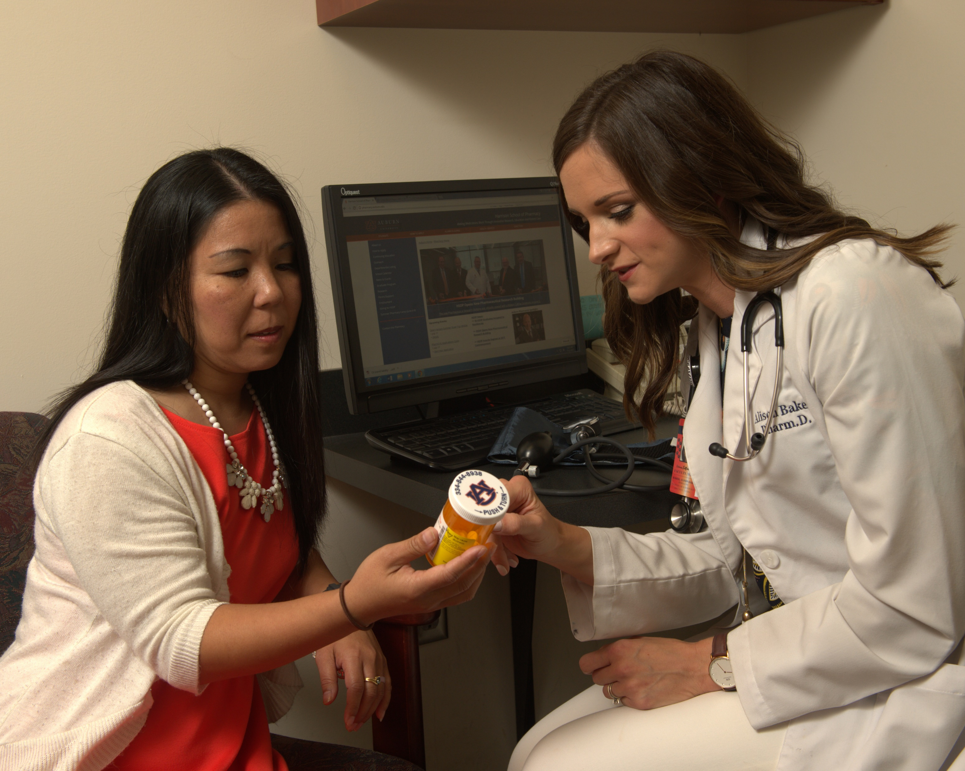
Now Accepting Applications
PGY-1 Community Pharmacy Residency Program
July 1, 2020-June 30, 2021
Location: Huntsville, AL
Business Administration
Compounding
Health and Wellness
Specialty pharmacy
Research
Ambulatory care services
Dispensing pharmacy
Advocacy
Teaching
Population health
The Harrison School of Pharmacy and Star Pharmacy are excited to announce a new PGY-1 Community Pharmacy Residency opportunity starting in 2020. Residents trained in this program will gain over 2,000 hours of advanced education and training focused on developing patient care, practice management, and leadership skills. Additionally, residents will have the opportunity to conduct research and present at national and regional pharmacy conferences. If you’re interested in community pharmacy and ambulatory care, this may be the residency for you!
INTERESTED?
Email a CV and letter of interest to pedengc@auburn.edu

